Slide 1
BCA
SEM :-1

Slide 2
Co:-103
COMPUTER ORGANIGATION
DL PIMT BCA COLLEGE
HIMATNAGAR
MAJOR PART OF COMPUTER

Slide 3
REPRESENTED BY…..
Parmar Minaxi d.
Parmar Damini S.
Parmar Gaytri n.
Patel Mittal.
Vaghela hiral k.
Parmar khushbu g.

Slide 4
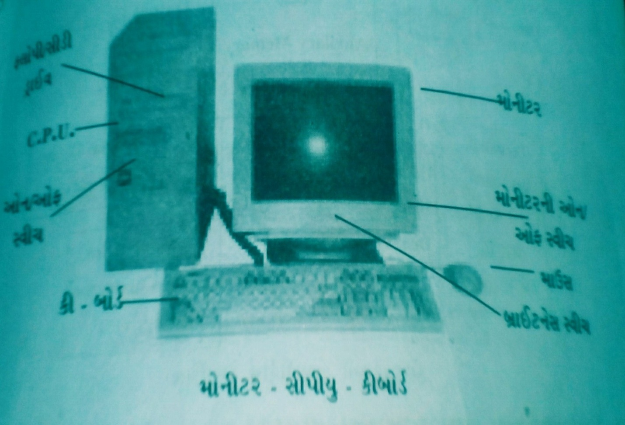
PART OF COMPUTER
FLOPPY DISK DRIVE
monitor
CPU
ON OFF switch
On off switch
mouse
key- board
Brightness switch
Monitor- CPU- key board
There are many part of the computer like……
KEY BOARD
MOUSE
CENTRAL PROCESSING UNIT
MONITER SCREEN/VDU
ON /OFF SWITCH IN CPU

Slide 5

The digital computer system has three important parts.
Input device .
Central processing unit (CPU).
Output device.
.
Memory unit
INPUT
OUTPUT
Control unit
Arithmetic and logic unit

Slide 6
INPUT UNIT
Data and instruction must be entered into the computer system with input device.
Input unit is actually a device which used to communicate (input) with computer.
Input of any form is first converted in to BITS (0&1)
That easily understand by processing unit.
Example:- keyboard, mouse, , joystick.
Touch screen.
Thank you..

Slide 7
PROCESSING UNIT:-
Processing unit is also known as processer or CPU (central processing unit).
It is also known as the heart of computer.
It is very fast and powerful than other parts of computer.

Slide 8
The CPU itself is made of three component.
Arithmetic and logic unit
Control unit
Memory unit
ARITHMETIC AND
LOGIC UNIT
INPUT UNIT
OUTPUT UNIT
CONTROL UNIT
MAIN MEMORY
KEY BOARD
MOUSE
JOY STICK
PRINTER
MONITOR
SPEAKER
SECONDARY
STORAGE
FIG.2 :- INTERNAL STRUCTUR OF DIGITAL COMPUTER

Slide 9
ARITHMETIC LOGIC UNIT(ALU):-
It performs arithmetic functions like addition, subtraction, multiplication, division and also logical operation like greater than, less than and equal to.
it does all the operation with very high speed.
It consists number of registers to store temporary data.

Slide 10
MEMORY UNIT(MU)
The memory unit is used to store data and instruction.
After the completion of an operation, the output is stored into
memory.

Slide 11
CONTROL UNIT(CU)
The control unit directs all the operations inside the computer .
The function of the control unit is to execute the instructions of a program, one by one, in the desired like input , output and storage.

Slide 12
output unit
output unit unit work just in reverse manner than input unit
it sends the information from inside the computer to the out side world
basically the output can classify by to ways ..
1. hard copy i.e. direct usable
Form - may be in printed or plotted .
2. soft copy i.e. indirect usable form -may be in magnetic disk/ cd .
Continue..

Slide 13
The output can be converted to understand easily with any type for human being like...
1.on The screen by monitor
2. in printed paper by printer
3. in graphic form by plotter
4.. in sound by speaker
- ex. Monitor ,printer, speaker.

Slide 14
STORAGE UNIT :-
Storage unit is used to holding the data or information
Or instruction. There are two types of storage units.
Primary storage units
a units which is specially used in the computer or directly connected to CPU ,is called primary storage units.
Ex.. : register, cache memory, RAM.
Secondary storage units
a units which is specially used outside the computer or
[Continue..]

Slide 15
Indirectly connected to CPU , is called secondary storage unit.
Ex. :- HDD(hard disk drive), FDD(floppy disk drive) ,CD (compact disk), DVD (digital versatile disk)

Slide 16
ANY QUESTION ?

Slide 17
Thank you…..

